Slide 1
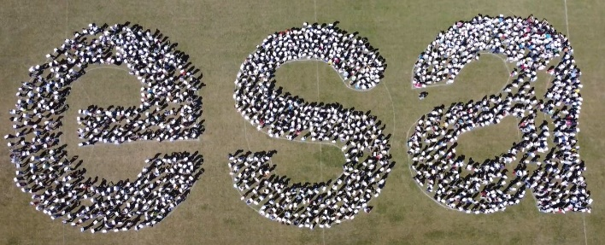
Space Passive Components Days
5th SPCD edition
ESA ESTEC 16/10/2024
Closure & Award session
Mrs. Karin Lundmark
Head of the Components Section

Slide 2
SPCD 2024
Jointly organized by
Co-sponsored by

Slide 3
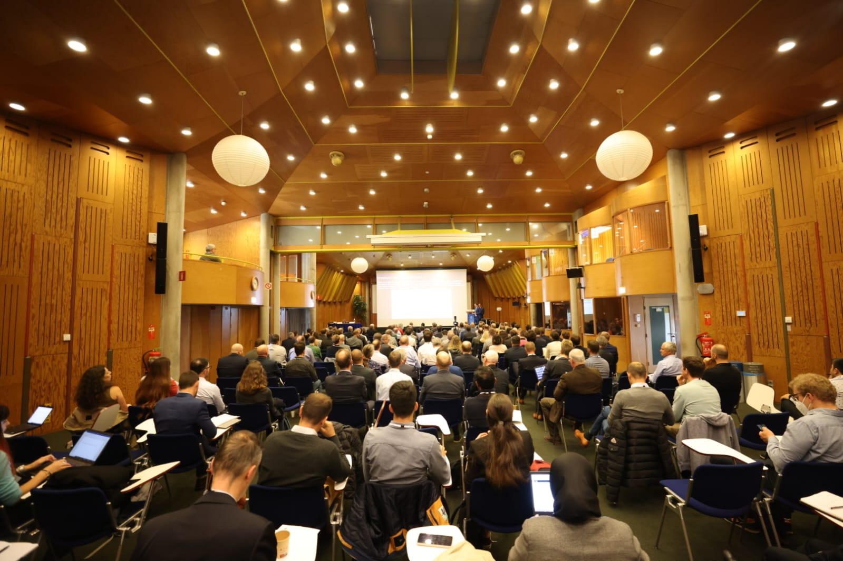
Thank you!
Final number:
248 participants!

Slide 4
Proceedings
Presentations and Proceedings will be available under:
www.spcd.space
You can fill the survey and direct you to the website to download all proceedings (presentations, papers, etc.)

Slide 5
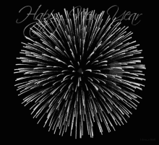
A big thank you to the
ESA conference Bureau team!
Tessa Rowbottom

Slide 6
What Happens in SPCD stays in SPCD!

Slide 7
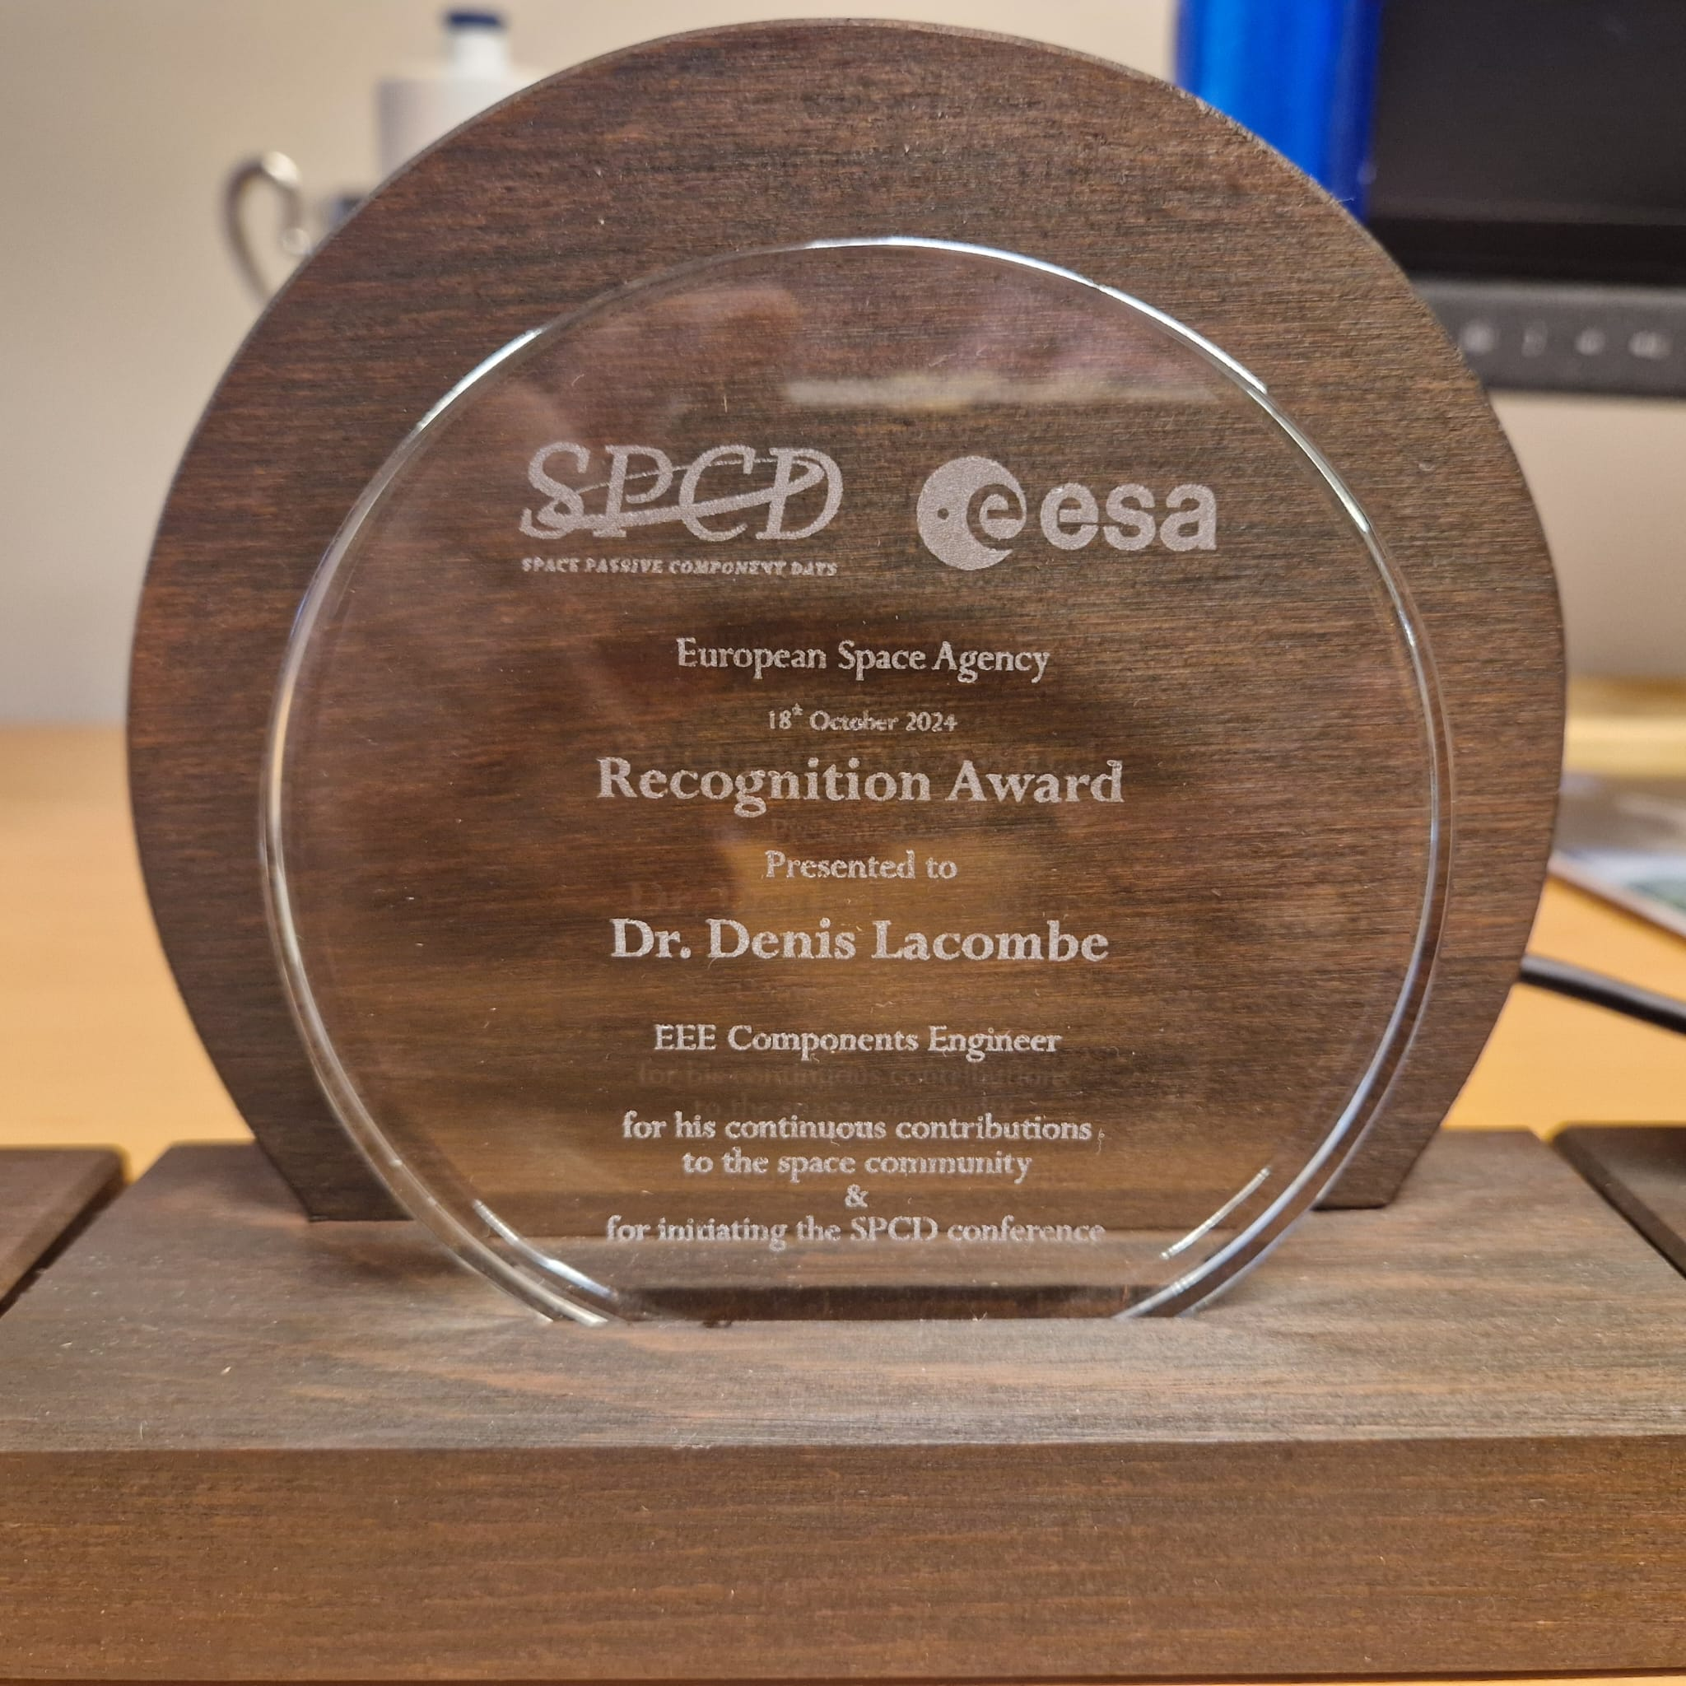
SPCD 2013 -> SPCD 2024 : 11 Years!, Thanks to…

Slide 8
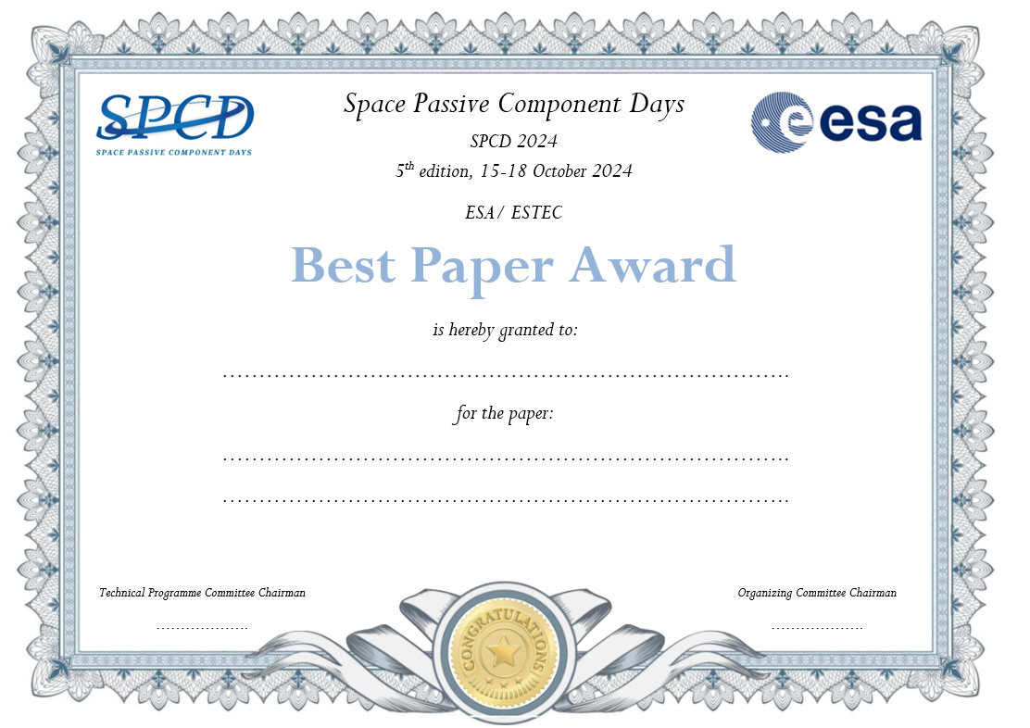
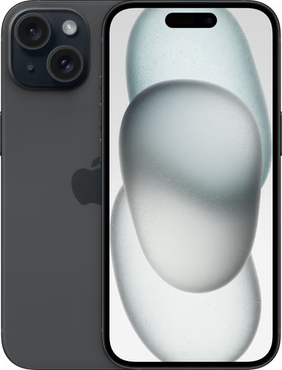
Best Paper Award
The SPCD Technical Programme Committee awards the best paper and the best poster authors. The selection is based entirely on the material submitted - abstract, full paper and presentation.
ALTER TECHNOLOGY
Qualification for Cryogenic Testing for EEE Components for ESA ARIEL
Apple iPhone 15
256GB Space Black

Slide 9
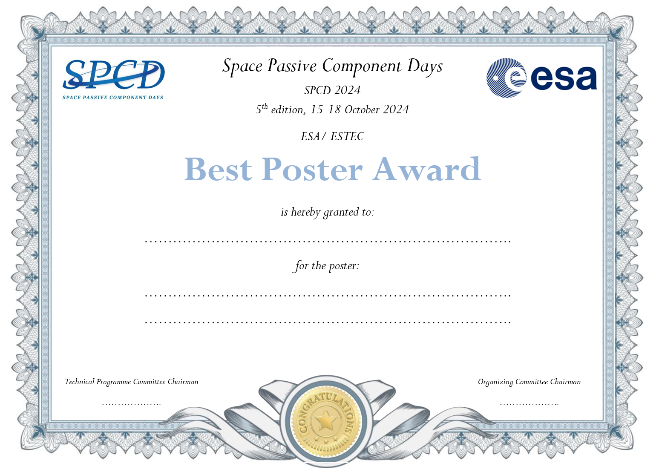
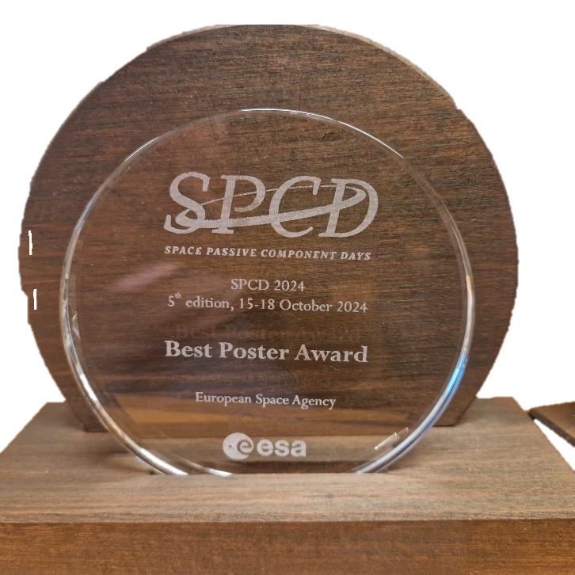
Best Poster Award
The SPCD Technical Programme Committee awards the best paper and the best poster authors.
The selection is based entirely on the material submitted - abstract, full paper and presentation.
EXENS SOLUTIONS
LTCC SMD Circulator for
Space Applications
Apple iPad Air 11” 2024
256 GB Wifi + 5G
Space Gray

Slide 10
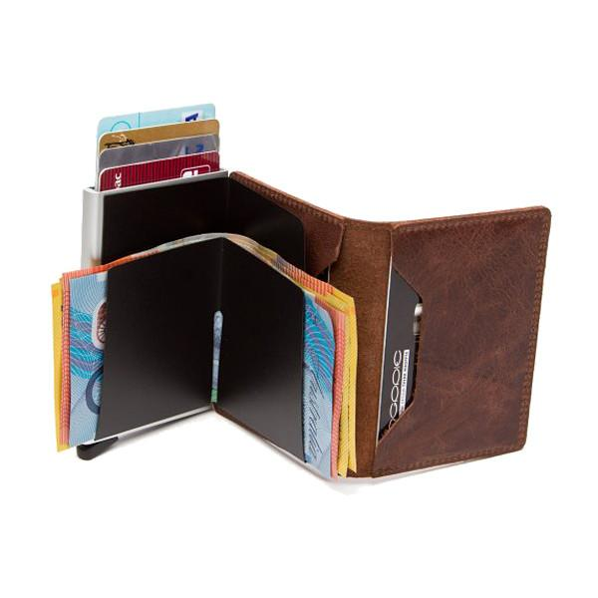
SPCD Space Fun Challenge
“In the cosmos I fly,
green and wise,
With red antennae to advise,
teaching with surprise.
Guess what I am,
a puzzle to unfold,
and the prize, a Secrid wallet
worth as gold,
only if your picture's the funniest bet. Capture my charm, and the wallet you'll get.”
Secrid Wallet
Made in The Netherlands!
Answer is:
PAXI

Slide 11
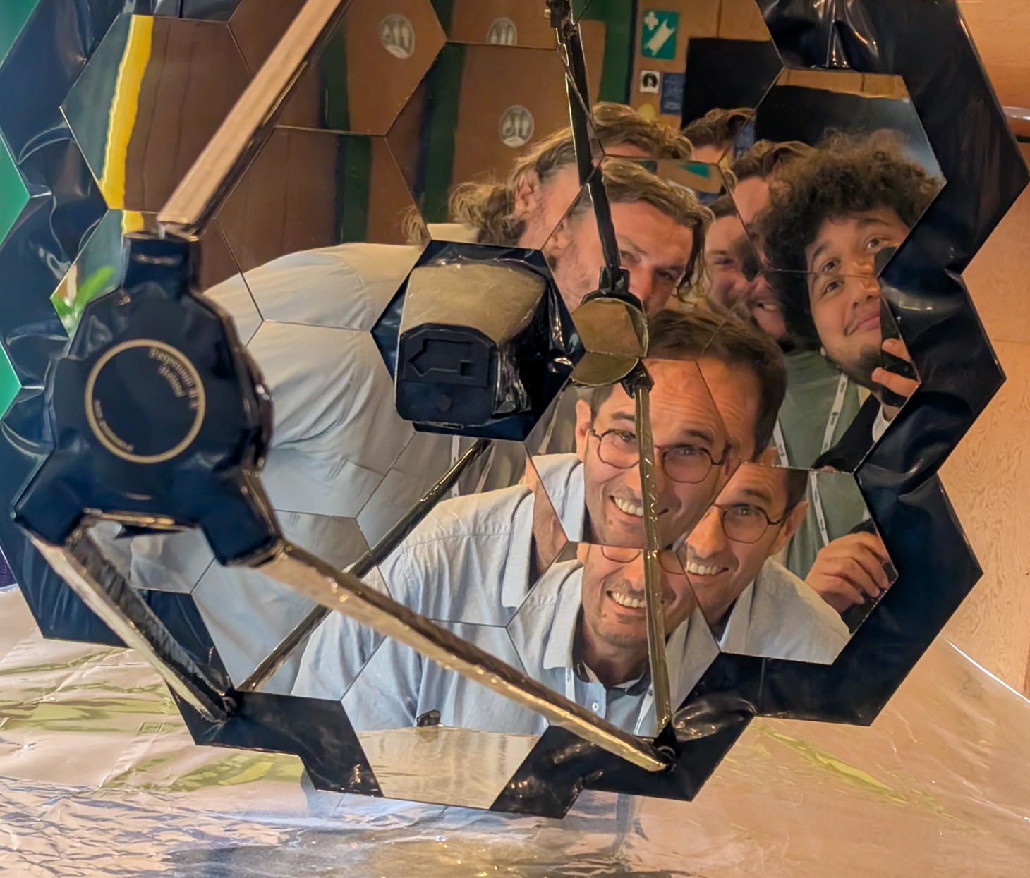
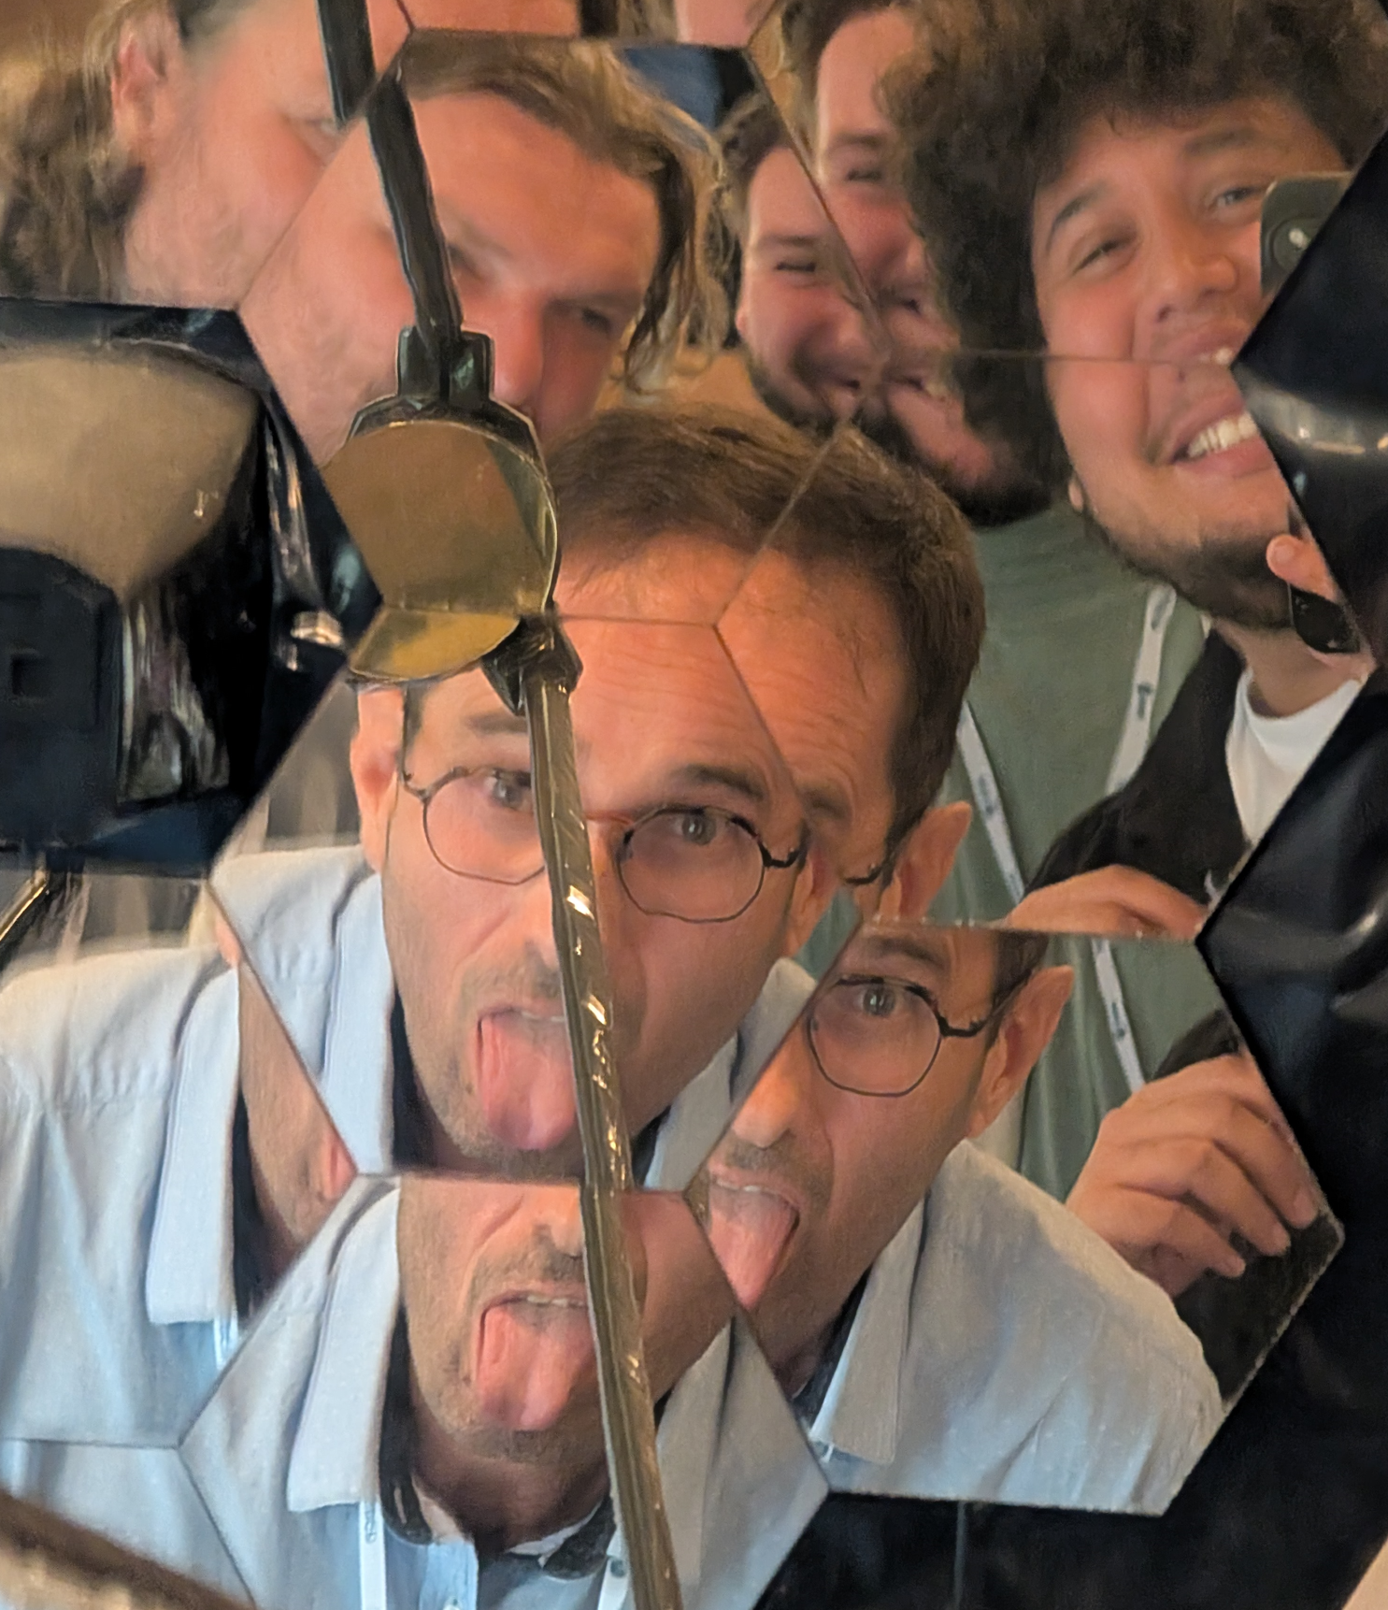
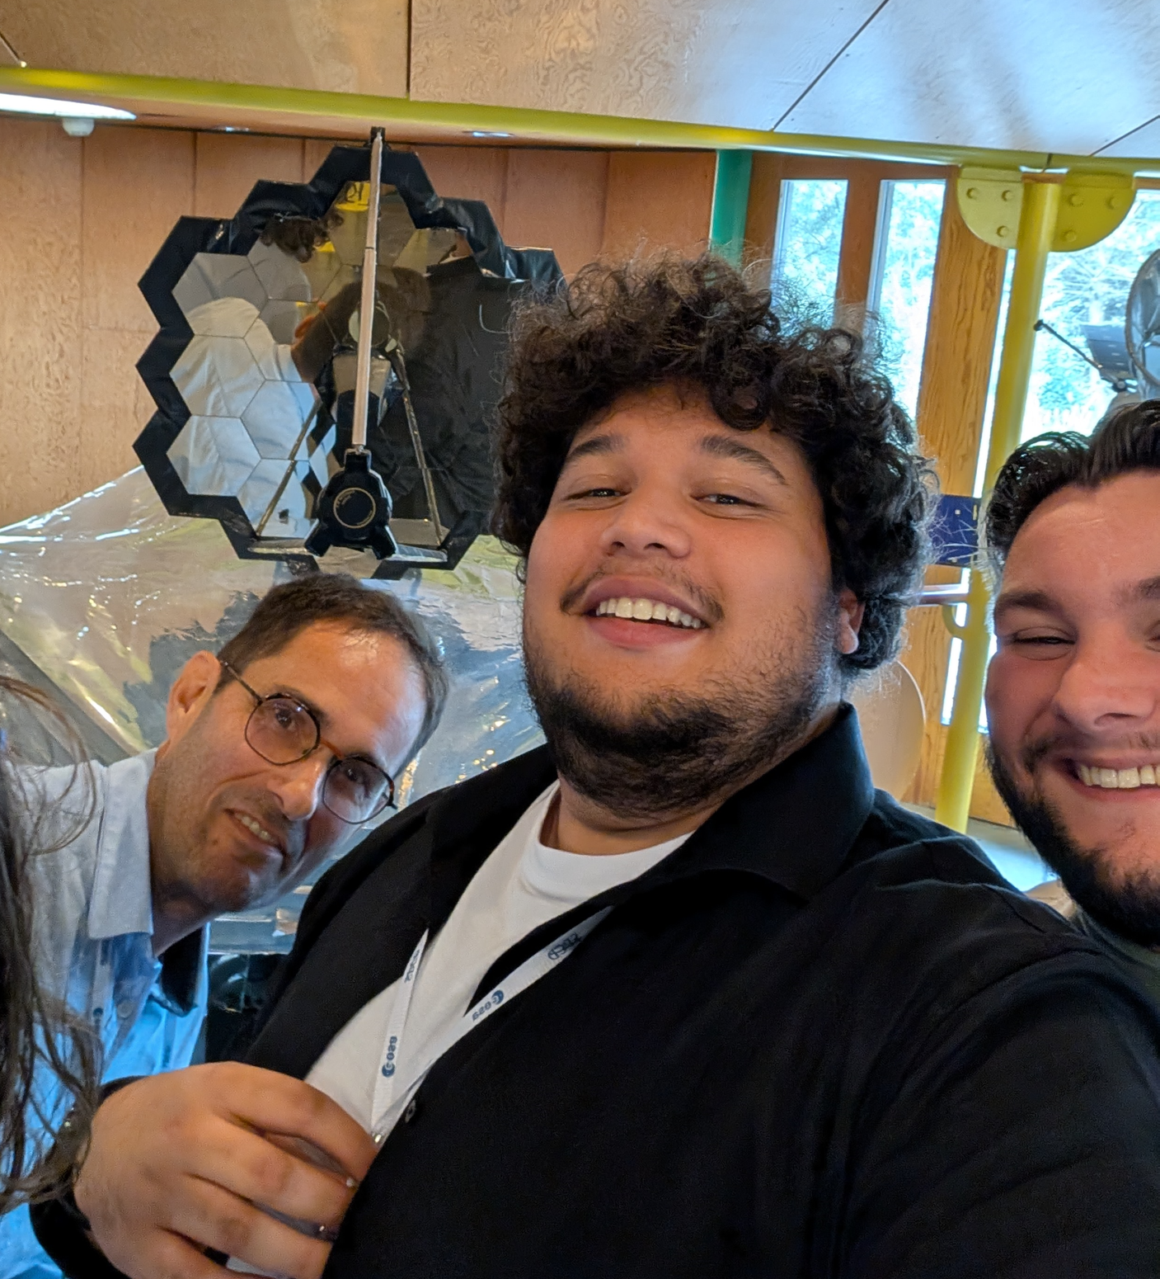
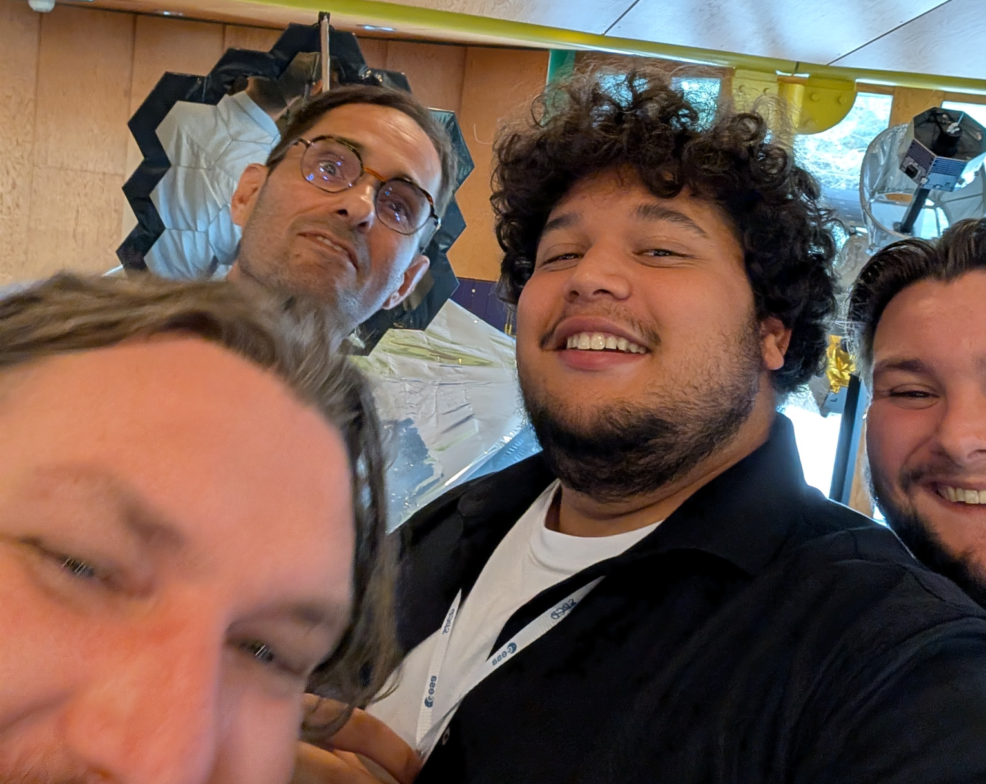
NOT The Winners…
RADIALL: We think it is JWST

Slide 12
NOT The Winners…
SRON

Slide 13
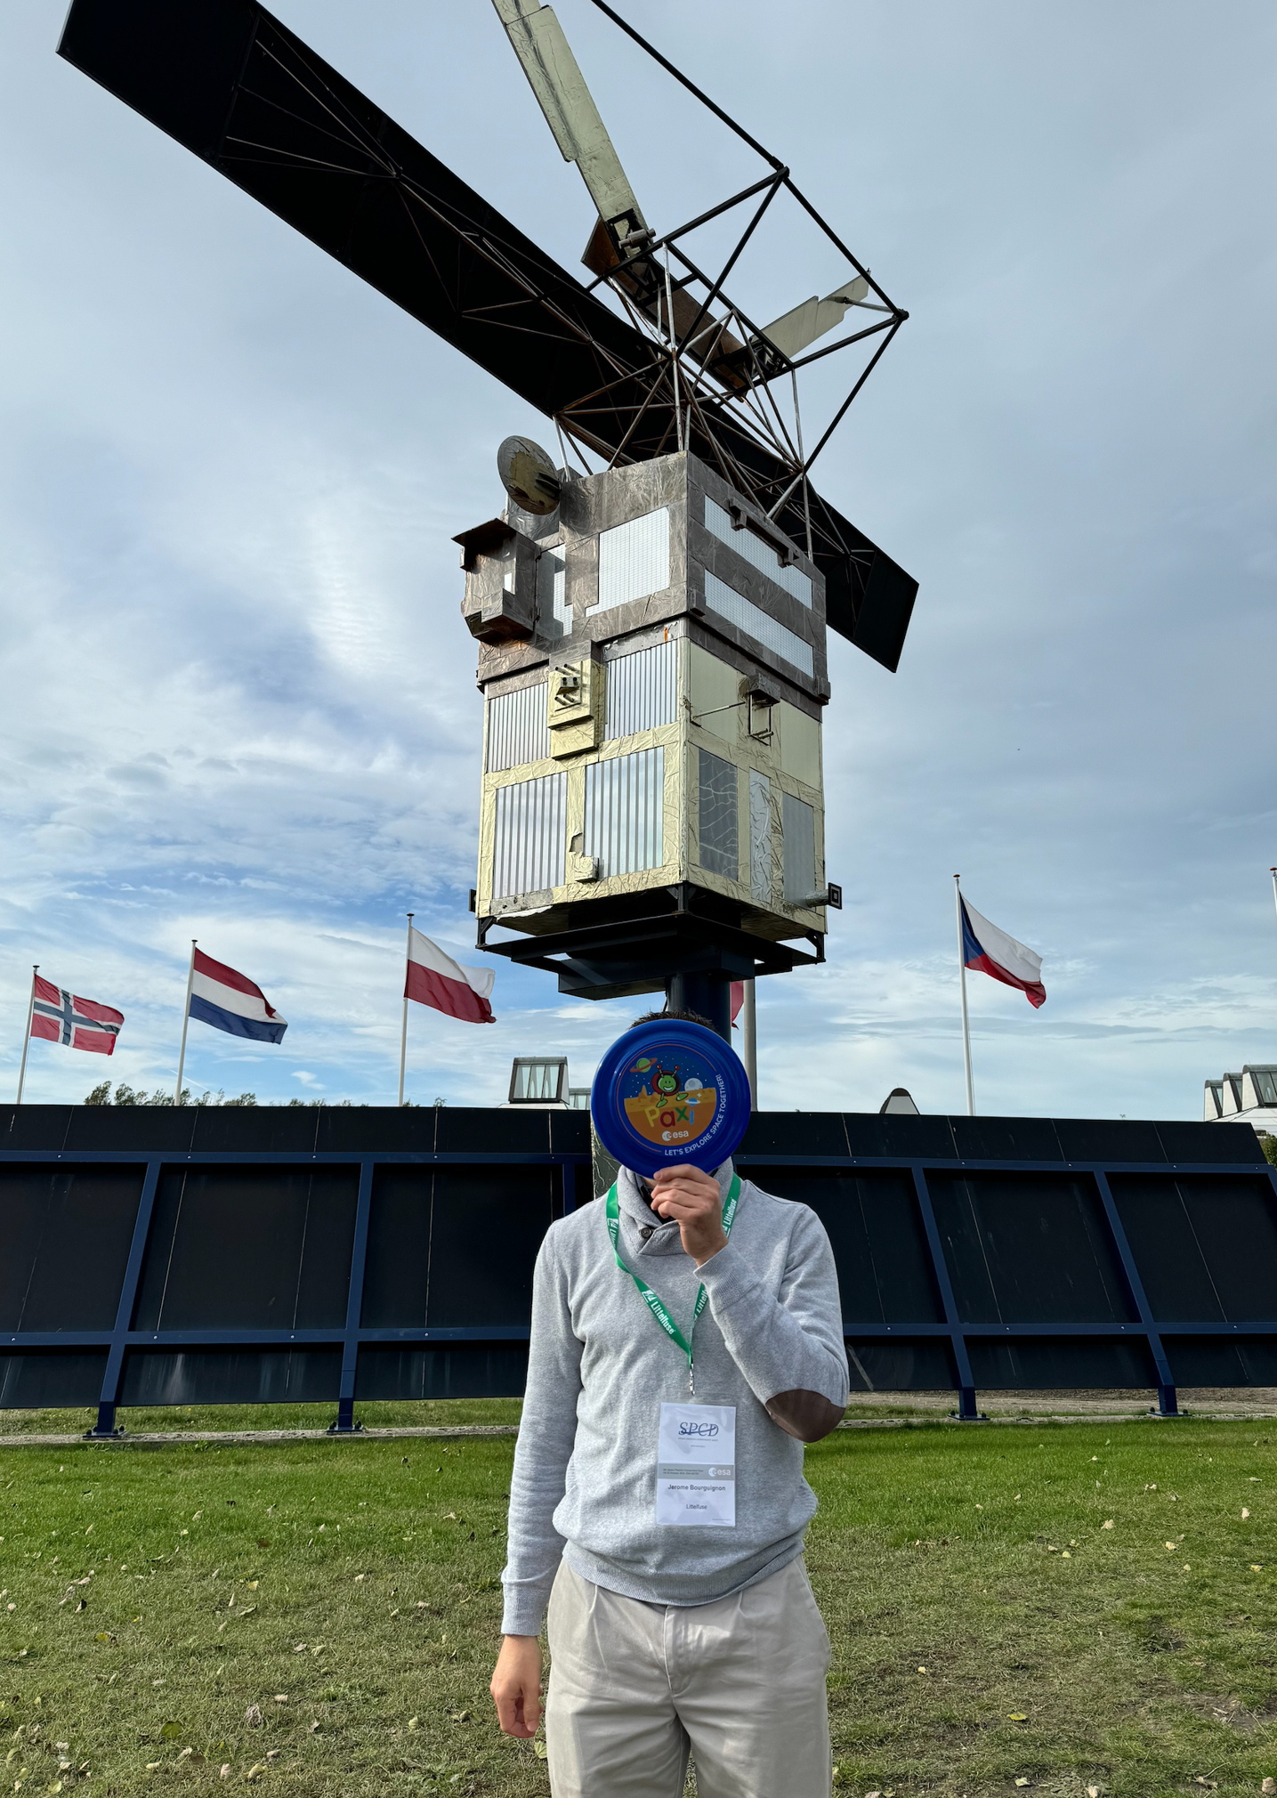
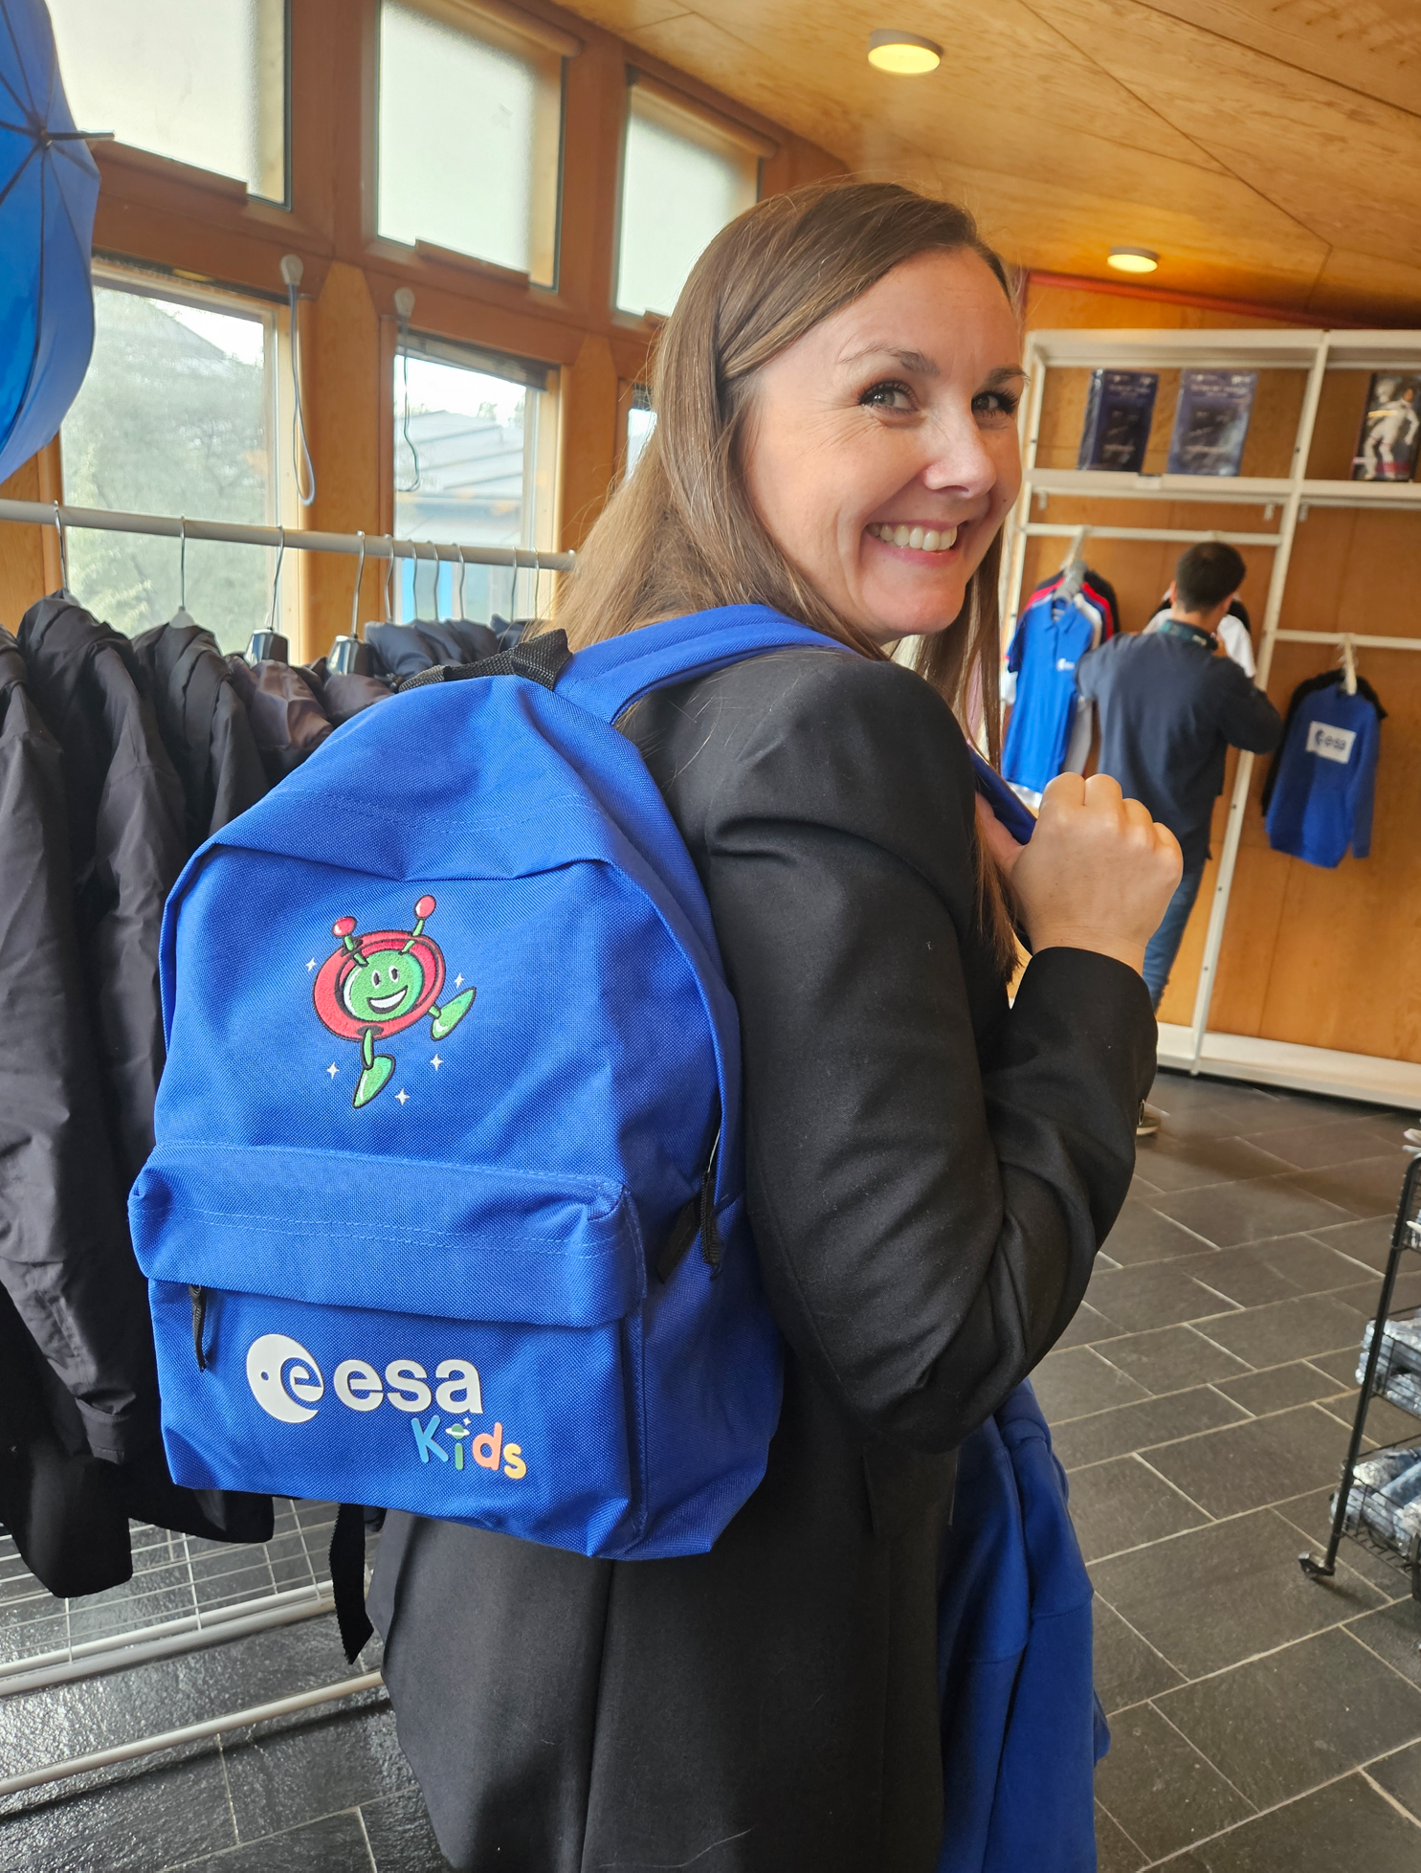
NOT The Winners…

Slide 14
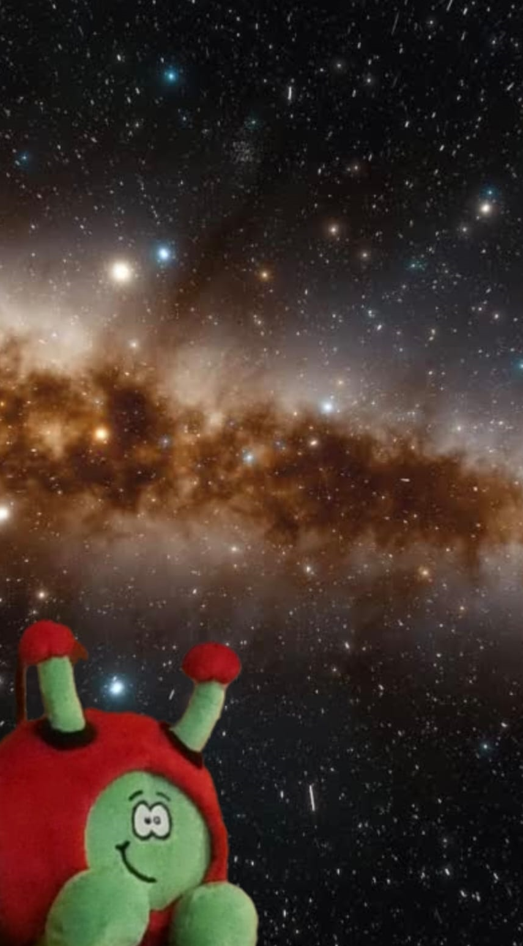
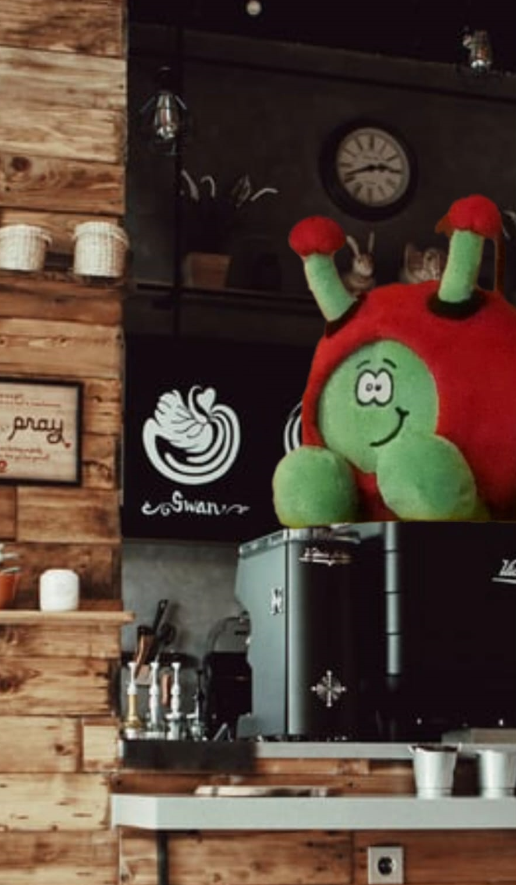
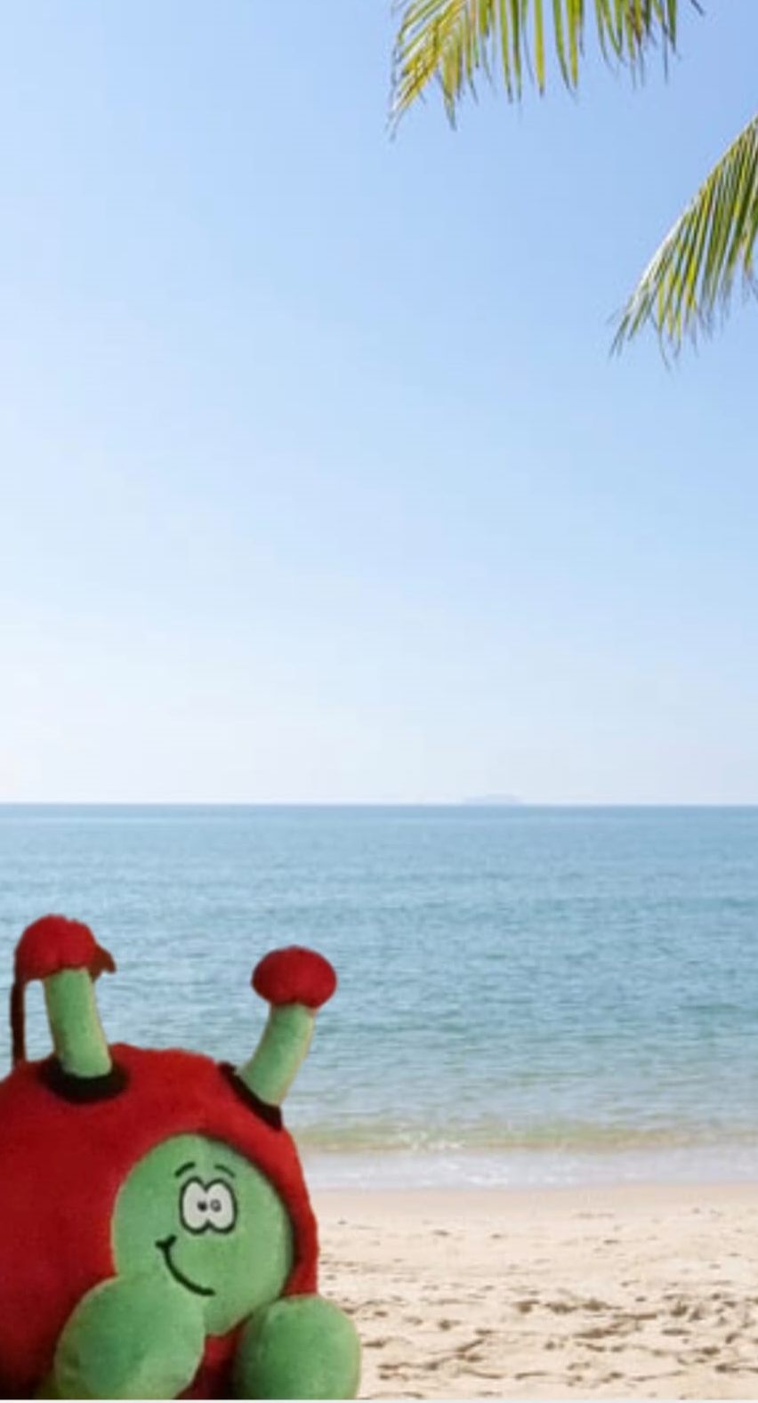
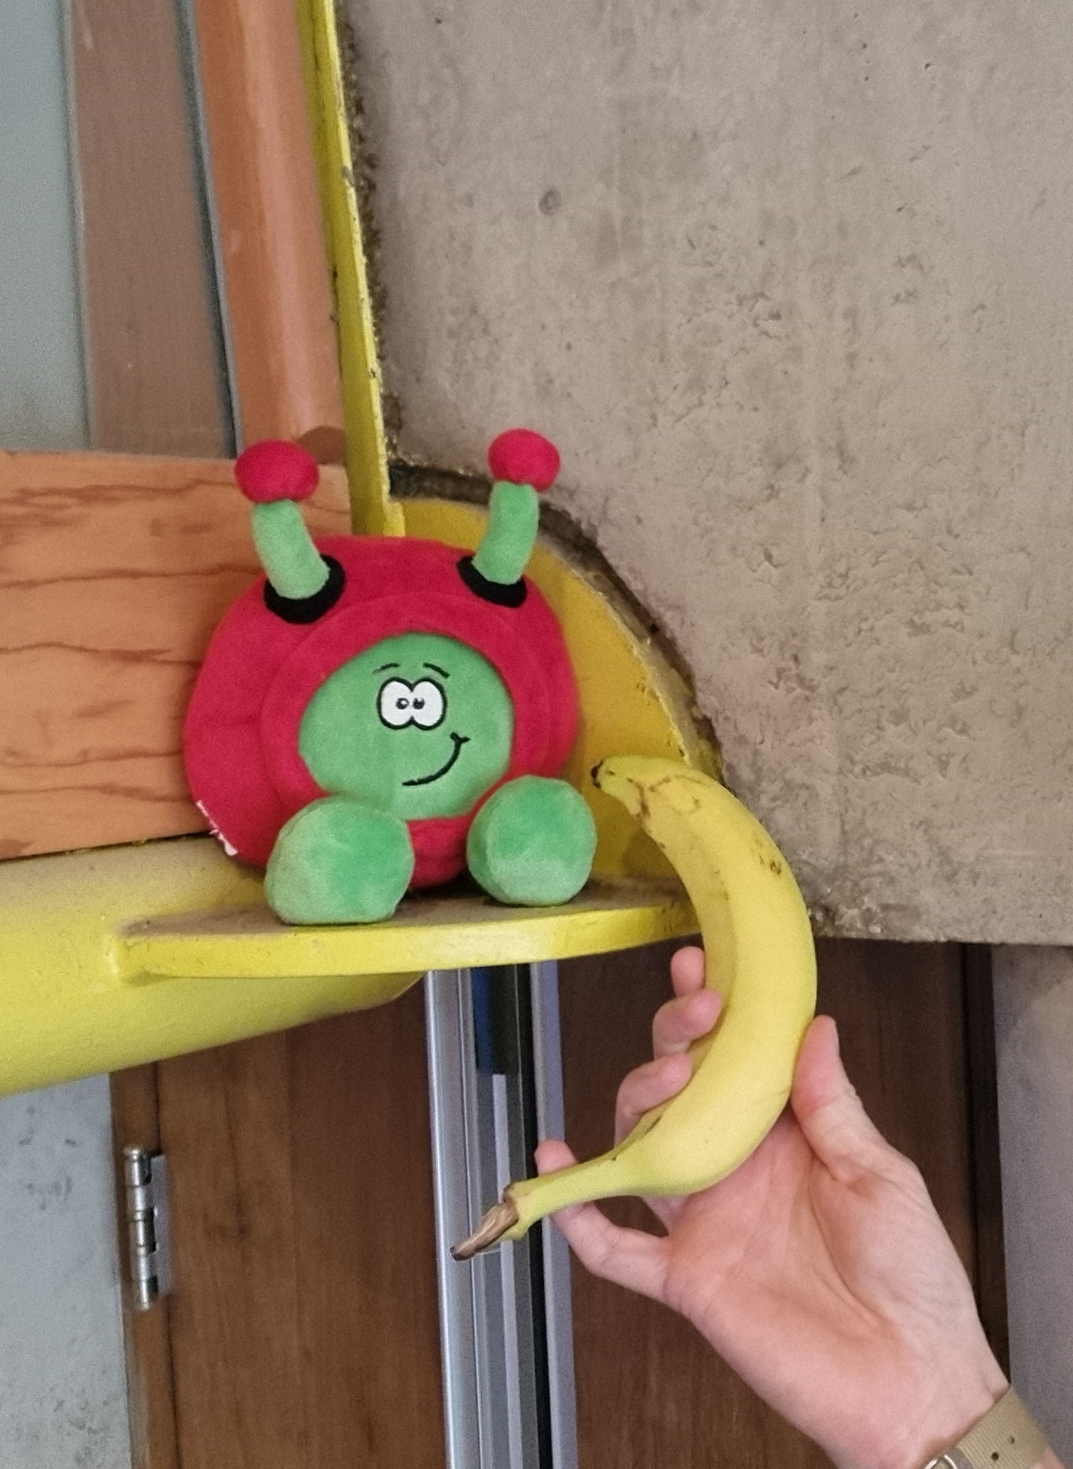
NOT The Winners…
CONCEPT POSITRONIC

Slide 15
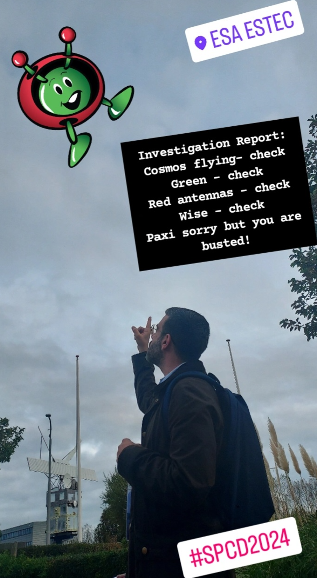
NOT The Winners…
PLEIONE

Slide 16
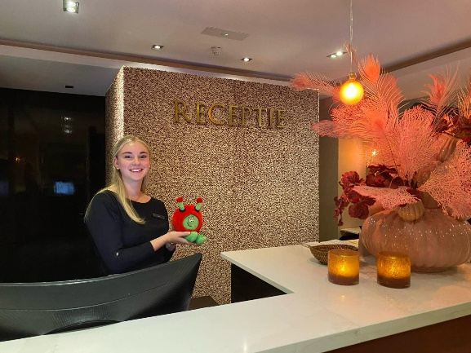
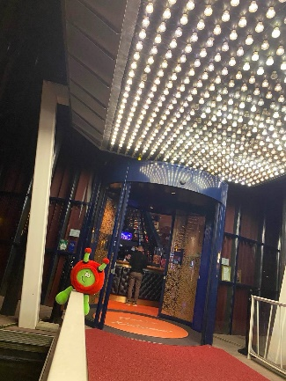
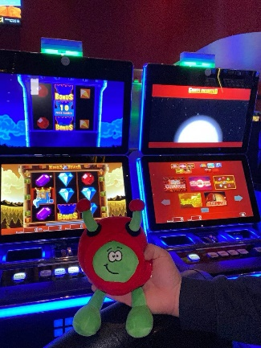
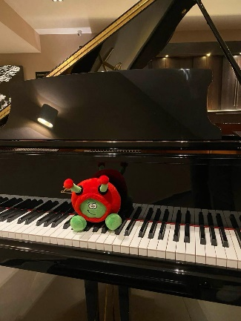
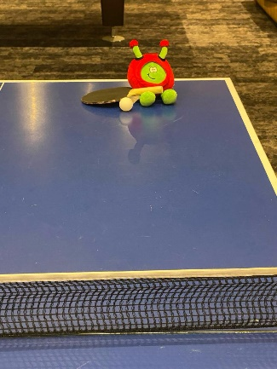
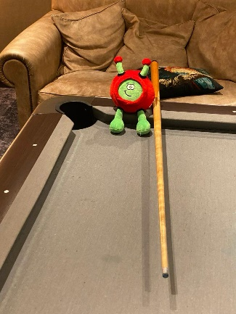
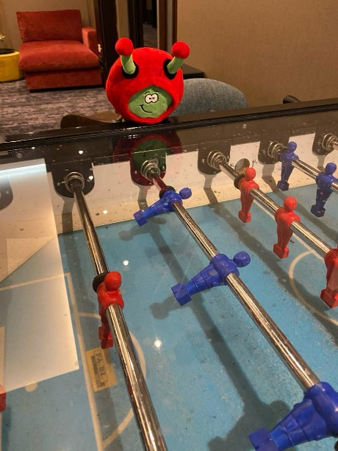
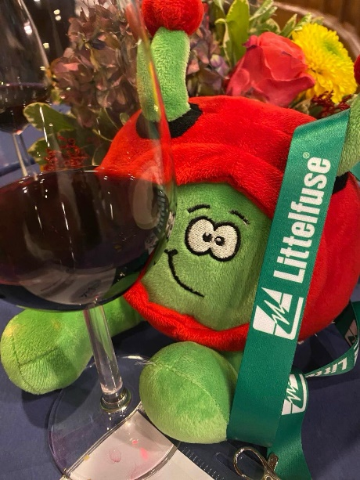
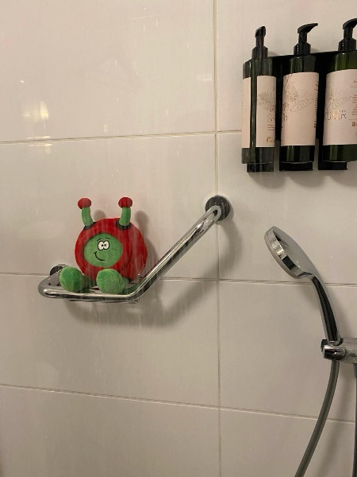
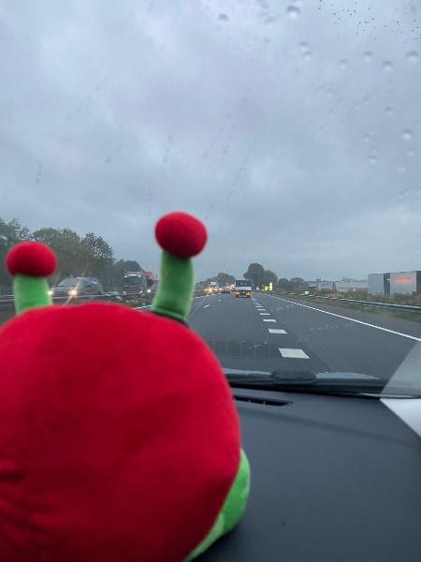
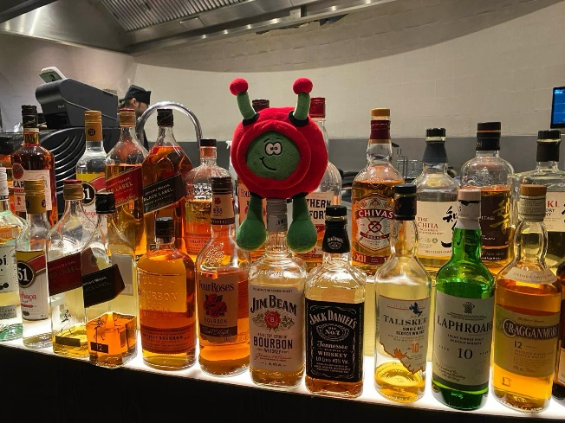
The Winners…

Slide 17
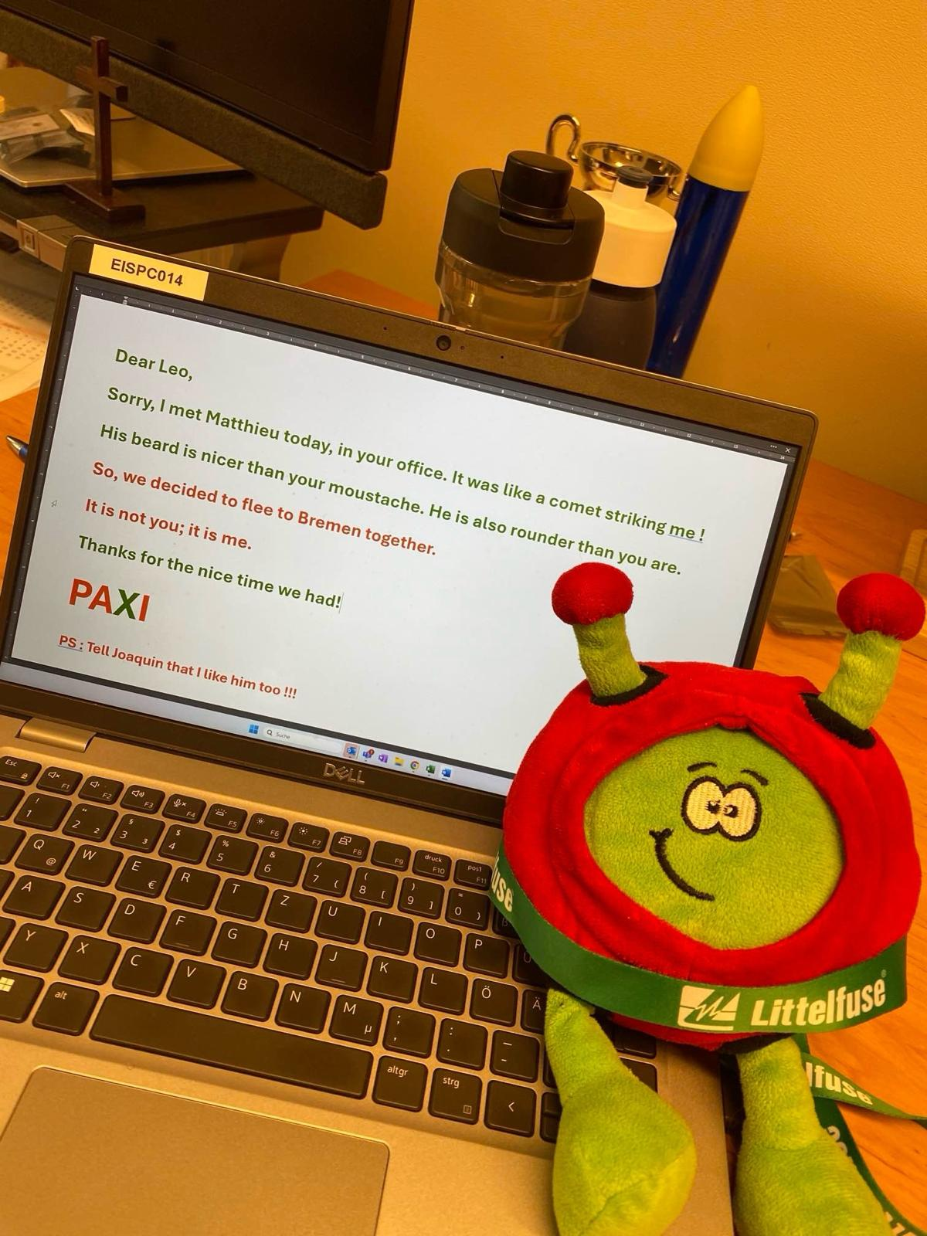
The Winners…

Slide 18
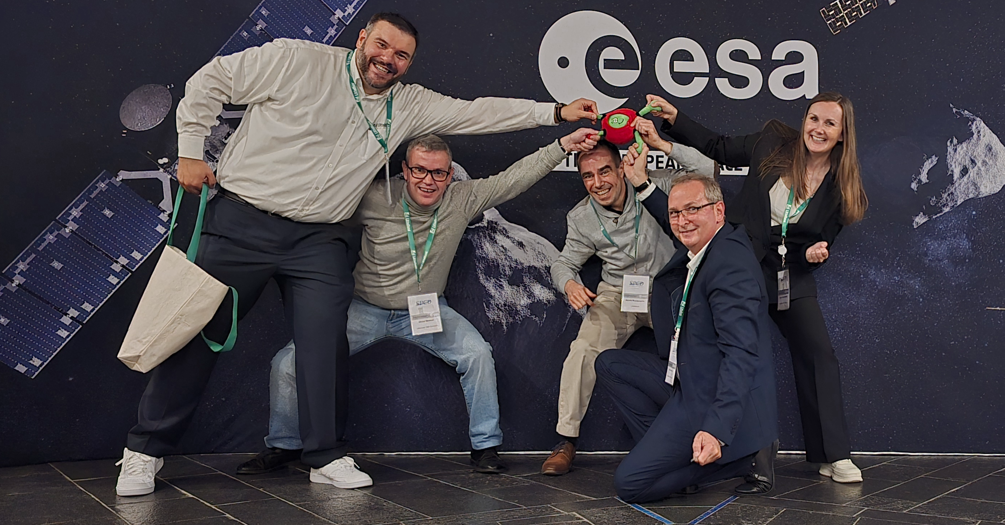
The Winners

Slide 19
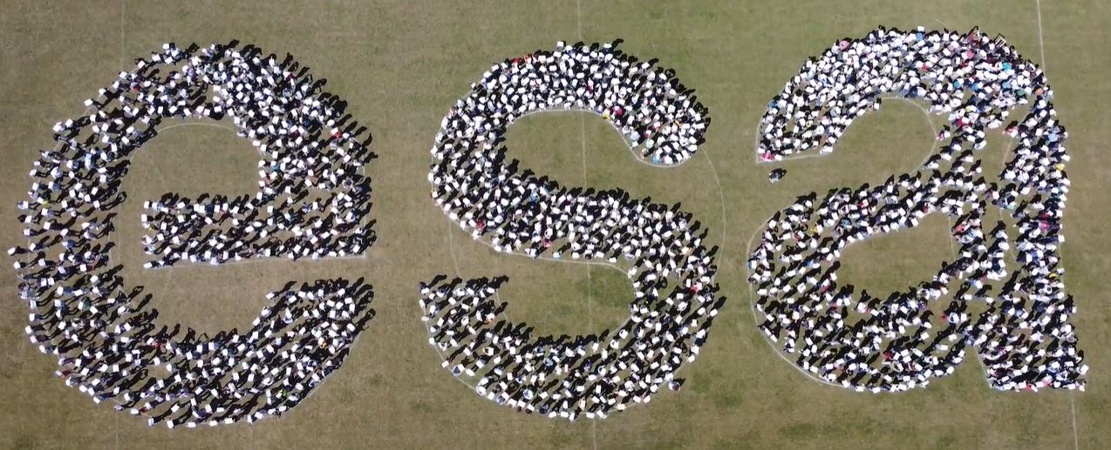
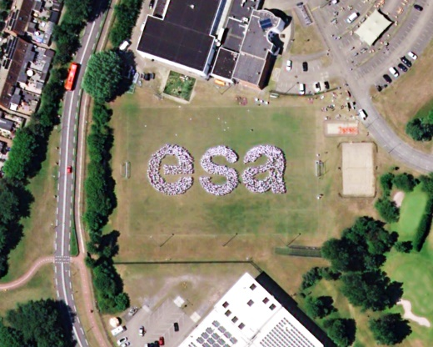
Space Passive Components Days
5th SPCD edition
Thank you very much!
See you in 6th SPCD 2026!

